Slide 1
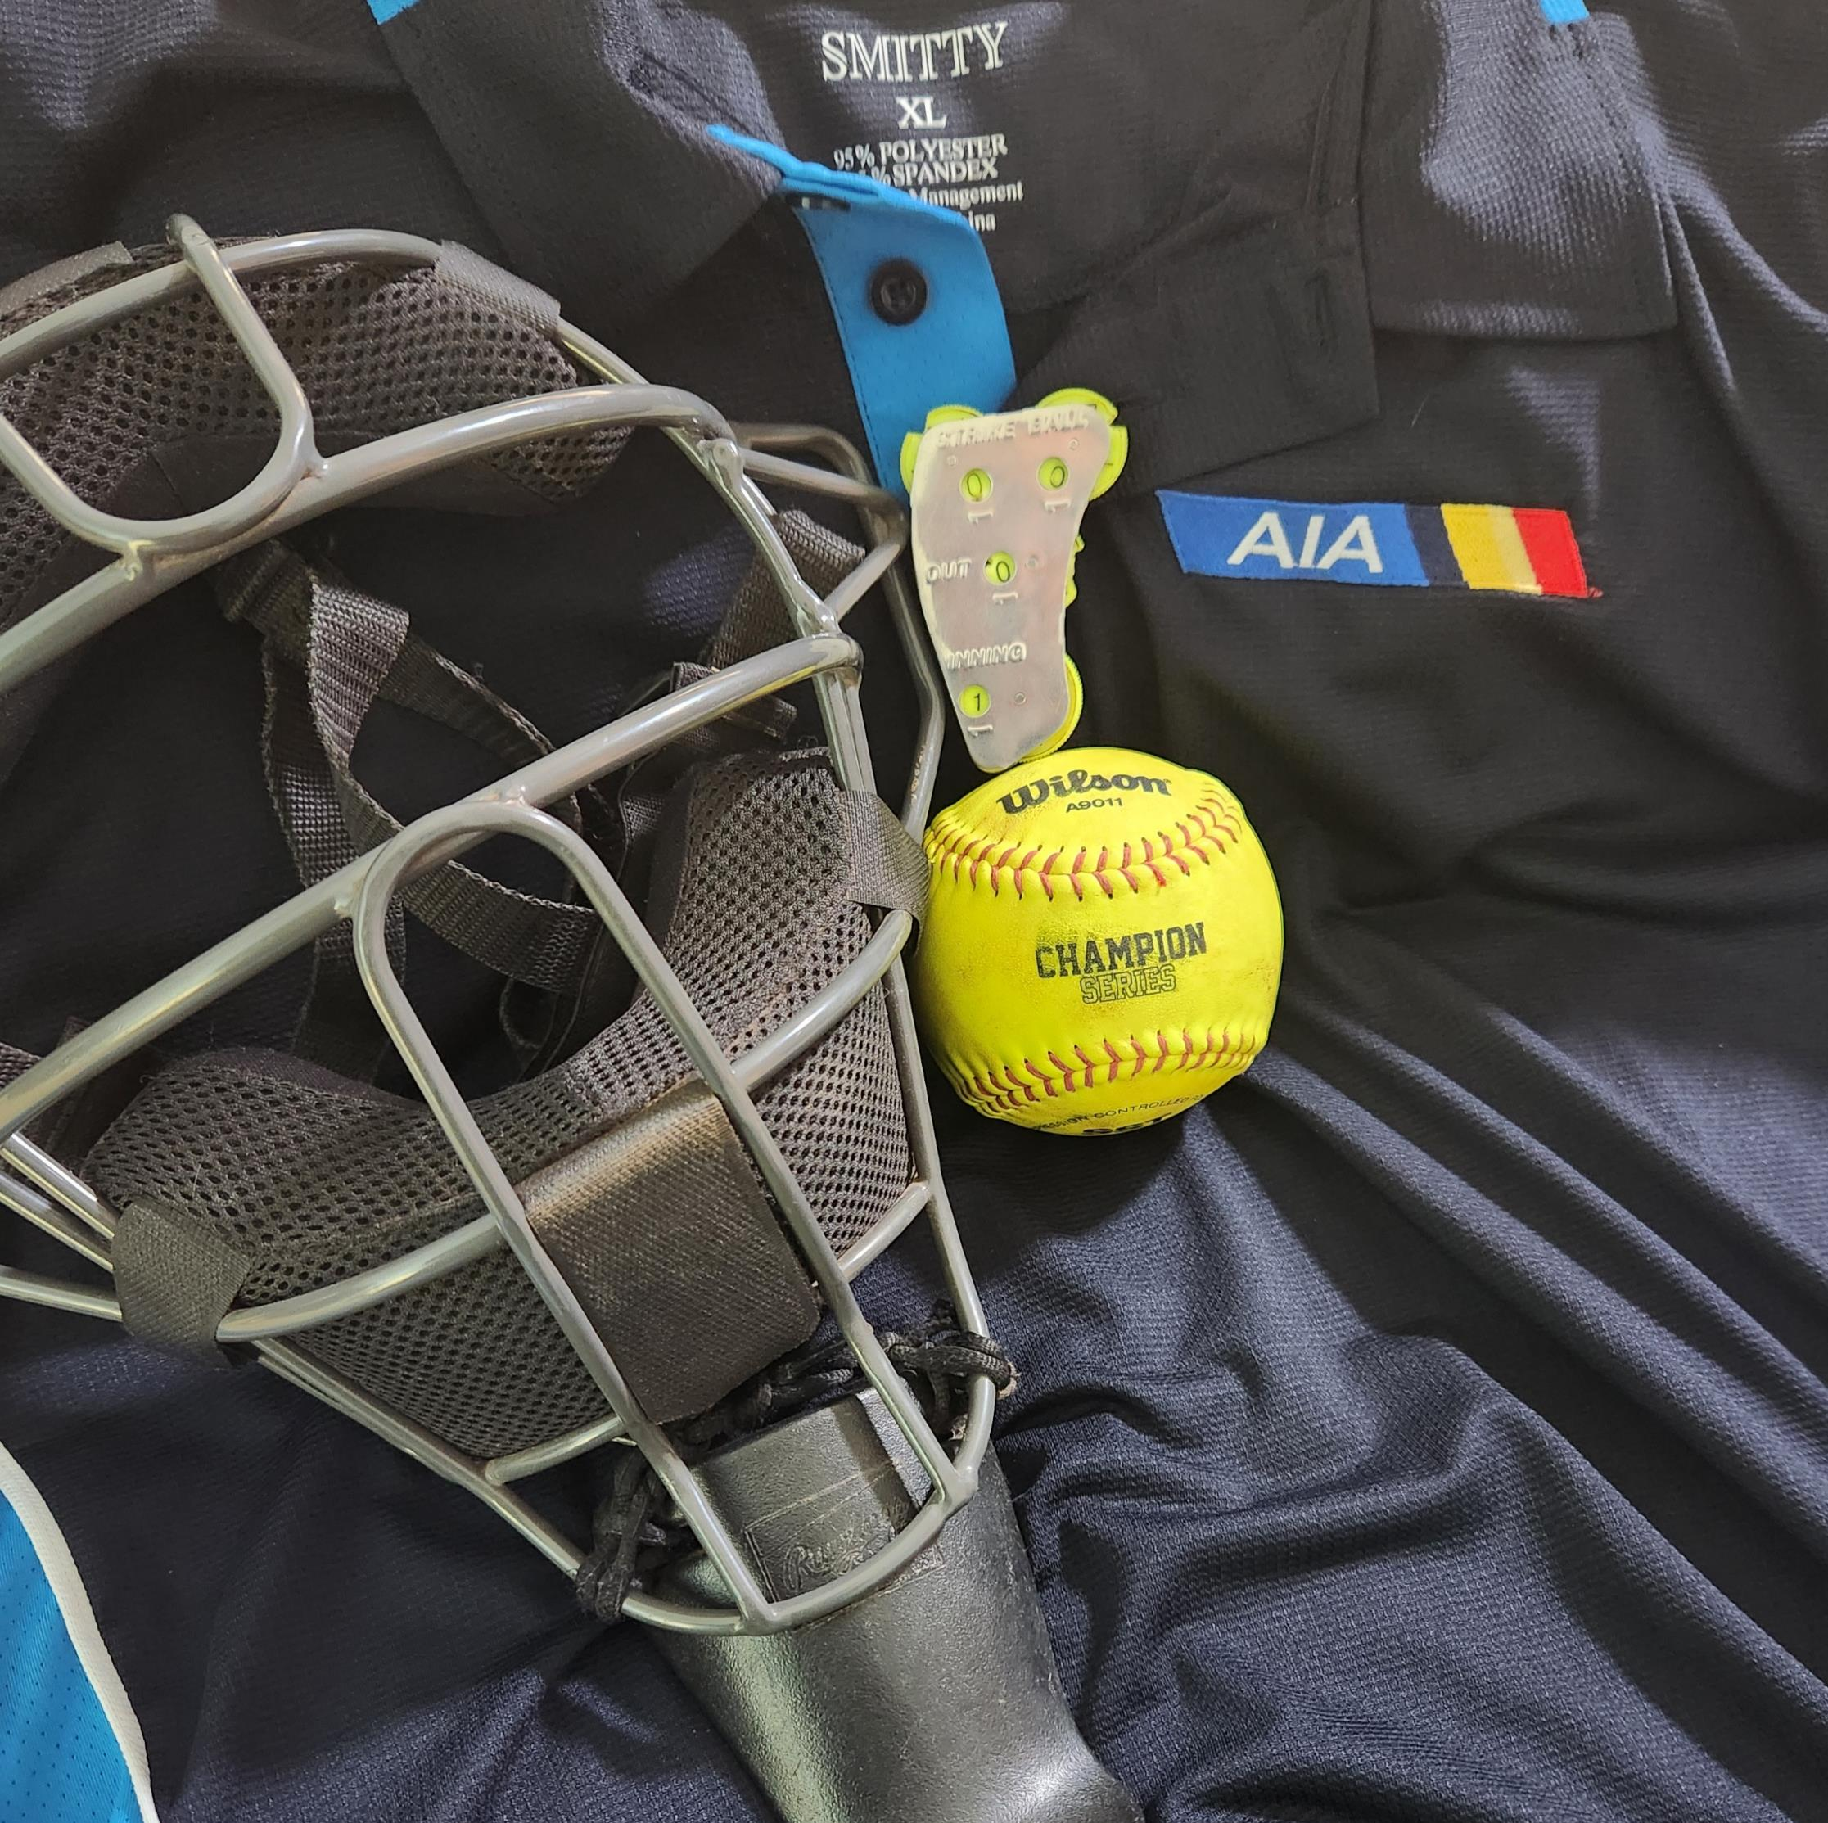
Arizona High School Softball Umpires Group
NEW UNIFORMS
1st Year Optional
Mandatory for finals
2nd Year Optional
Mandatory for Post Season
3rd Year Mandatory

Slide 2
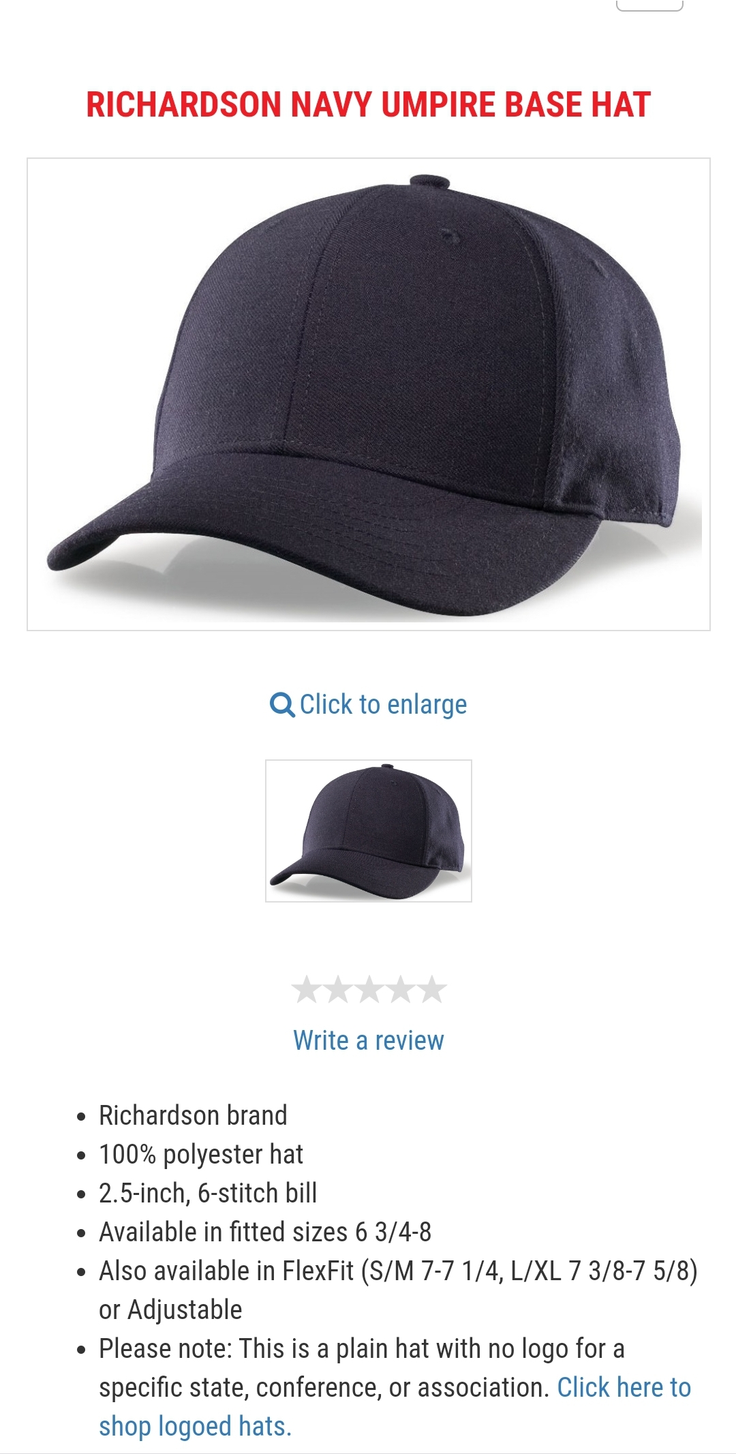
Arizona High School Softball Umpires Group Your Uniform

Slide 3
Arizona High School Softball Umpires Group Your Uniform

Slide 4
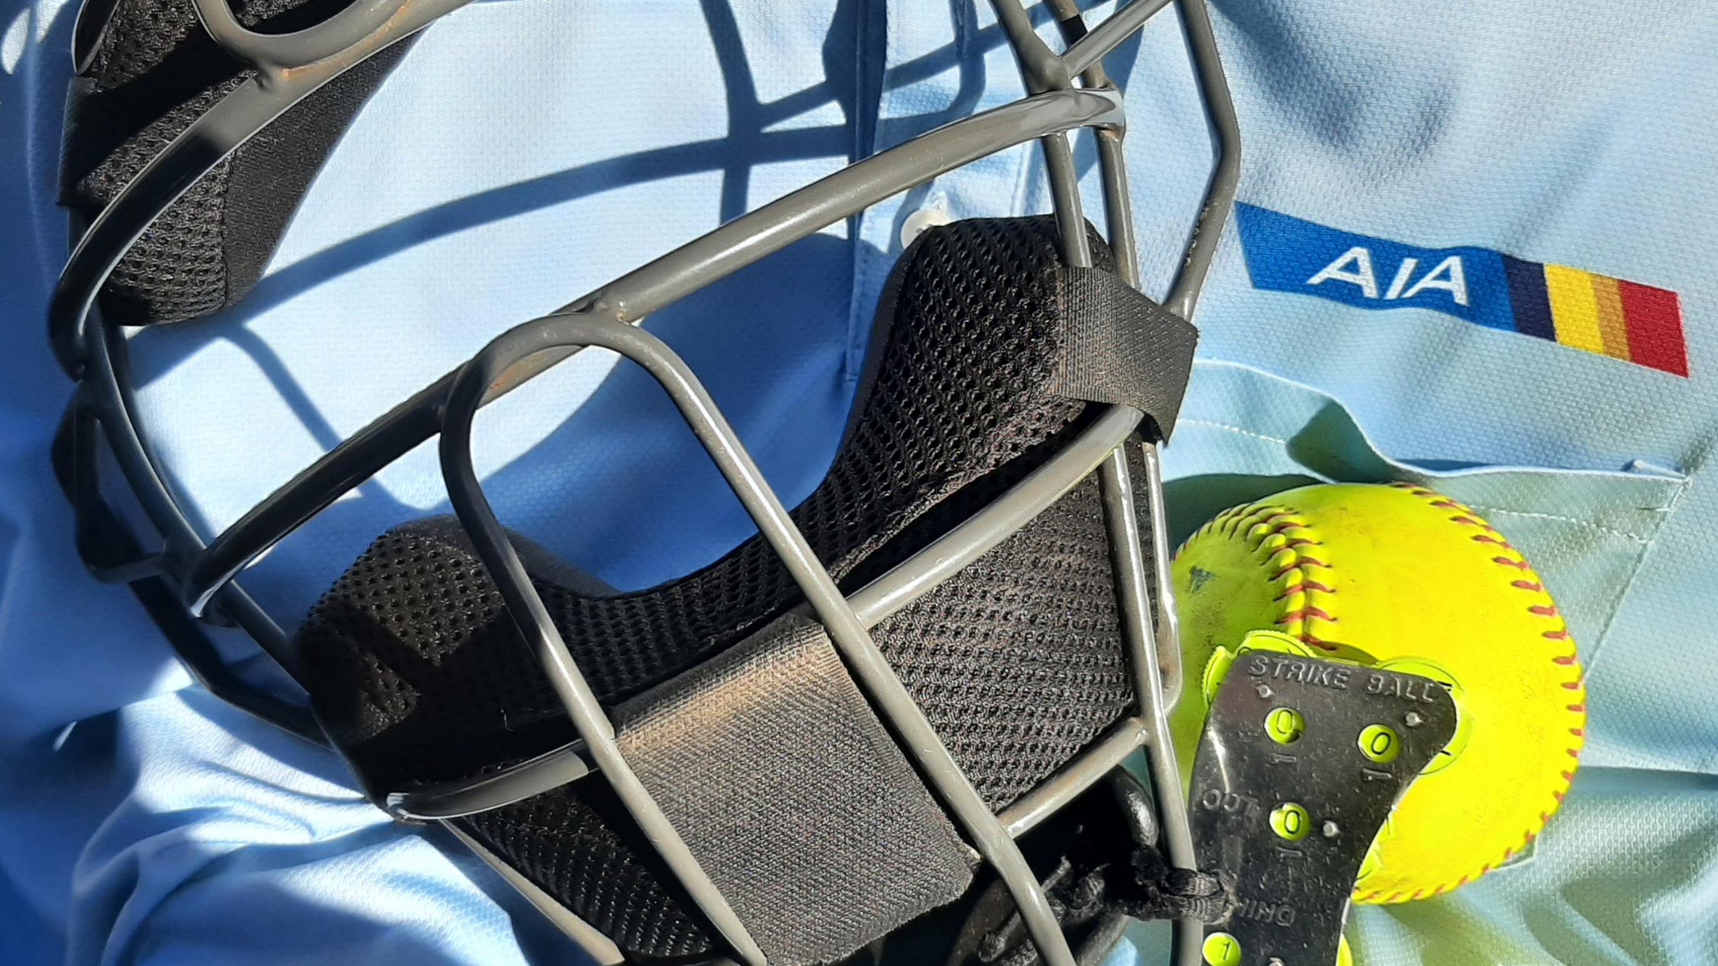
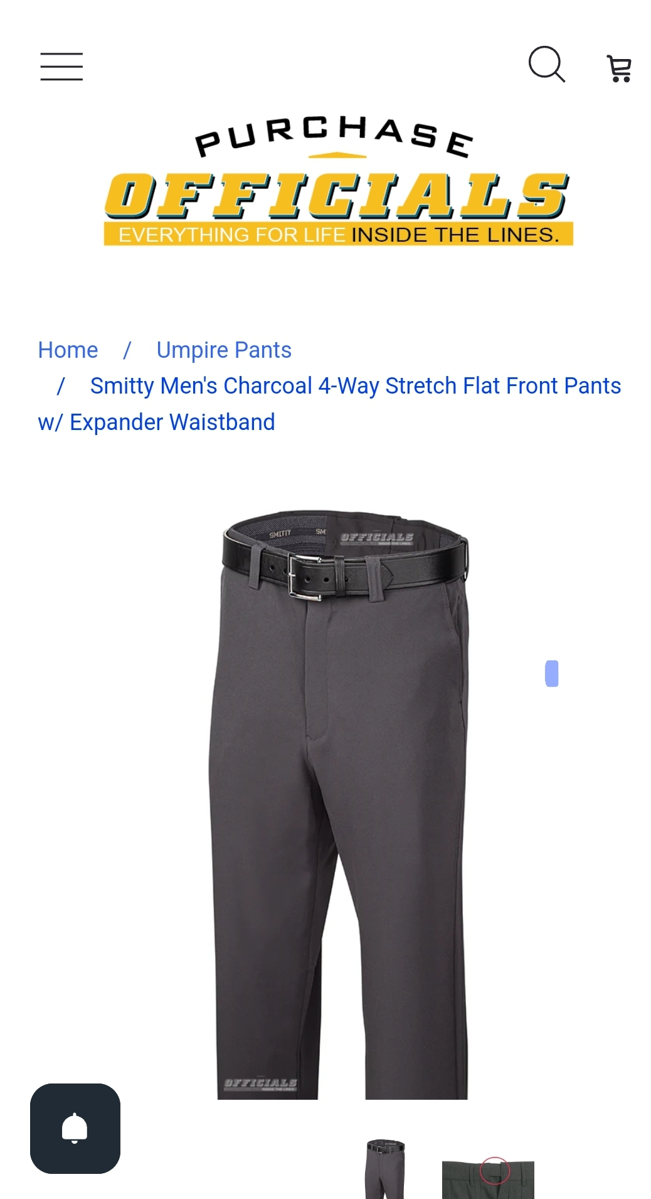
Arizona High School Softball Umpires Group Your Uniform
*Not to be Mixed.
*Heather gray with powder blue
*Charcoal with new navy blue
*Partners MUST match
*Powder blue is the default . It should be with you for every assignment

Slide 5
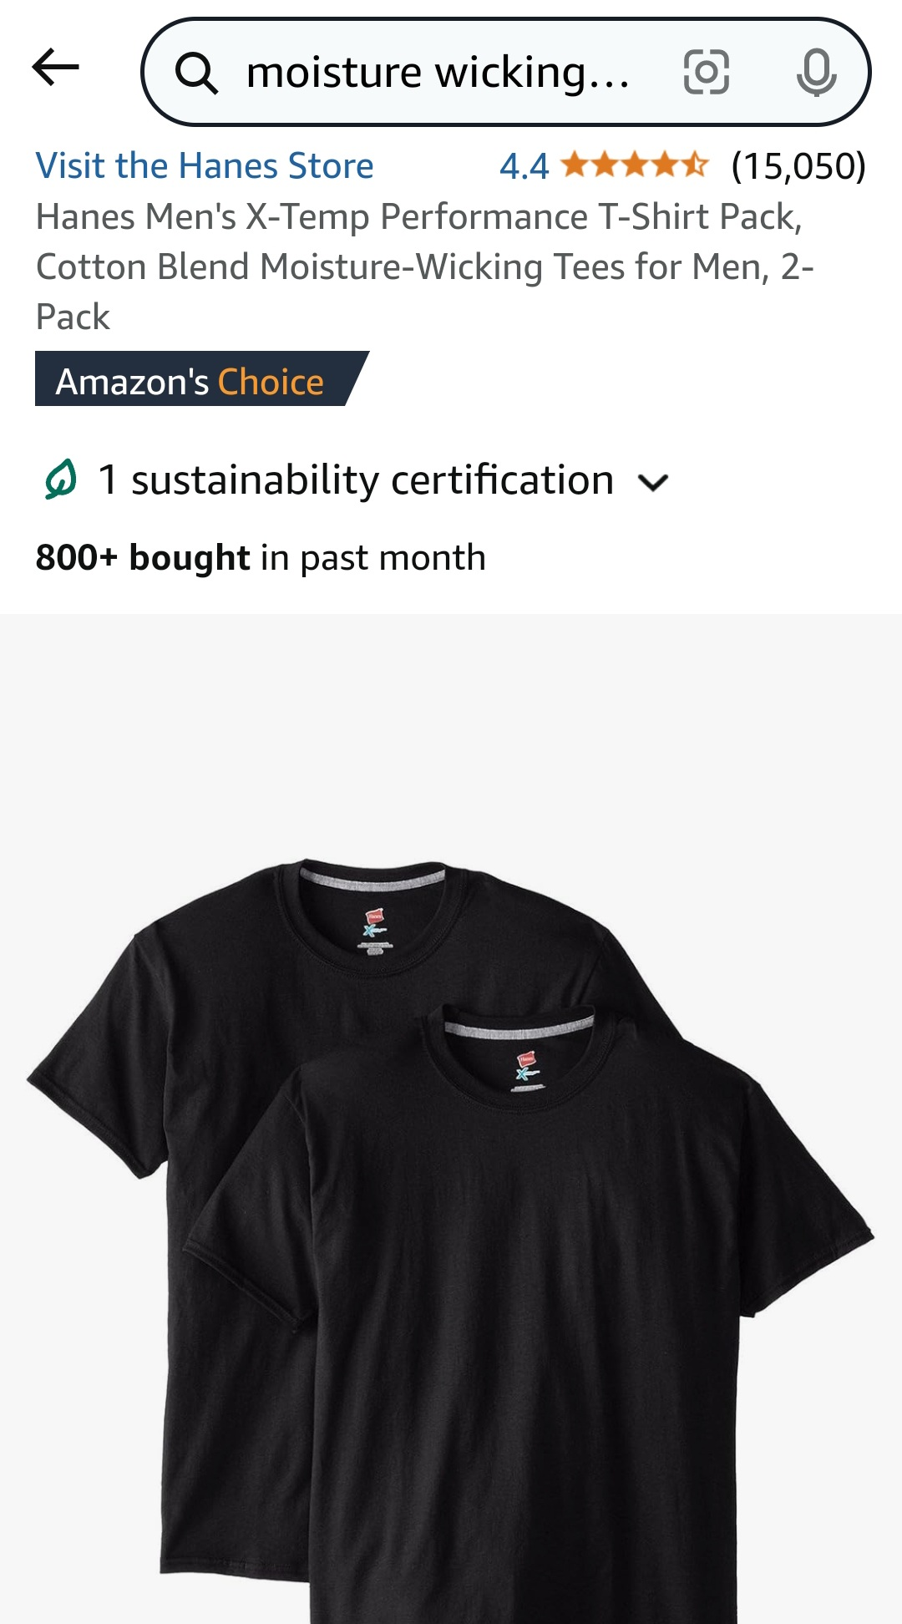
Arizona High School Softball Umpires Group Your Uniform

Slide 6
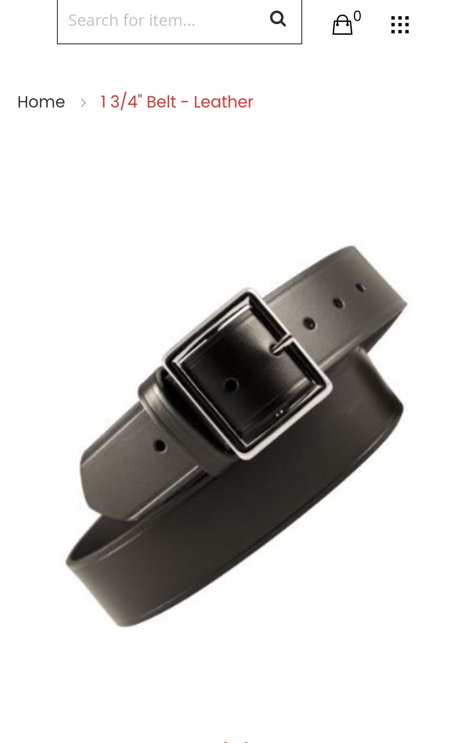
Arizona High School Softball Umpires Group Your Uniform

Slide 7
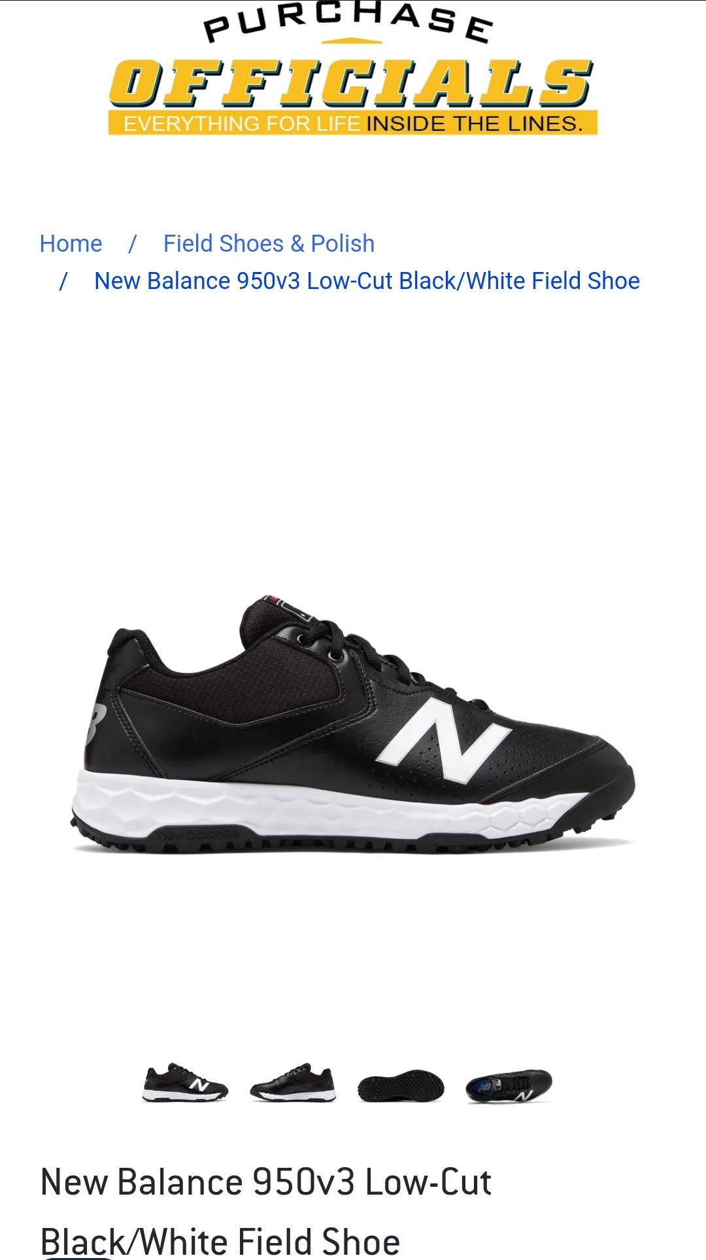
Arizona High School Softball Umpires Group Your Uniform
White highlights are fine

